Slide 1
Autonomous Subway Inspection Vehicle
Phase 2 Presentation
Senior Design
Omar Aziz, Noah Bolzoni, Brandon Castro,
Anthony Lucero, Sean Maggio, Marcin Wisniowski
Advised by: Professor Connington
November 14th, 2019

Slide 2
Outline
Background
Project Statement
System Design
Sensors and Control
Project Plan
Moving Forward
Problem
Feedback
Alpha Prototype
Technical Analysis
Deliverables
Notes:
Marcin

Slide 3
Background
Notes:
Marcin

Slide 4
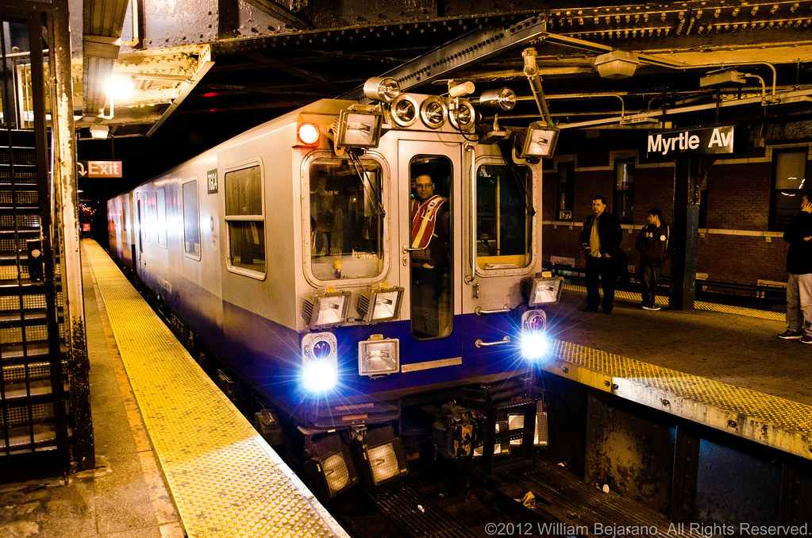
Background
Problem
5.7 million ride subway everyday
Too many delays
Track Geometry Cars are too few and too expensive
Reactive inspection & maintenance cause high costs
MTA Track Geometry Car
(Bejarano, 2012)
Notes:
Marcin

Slide 5
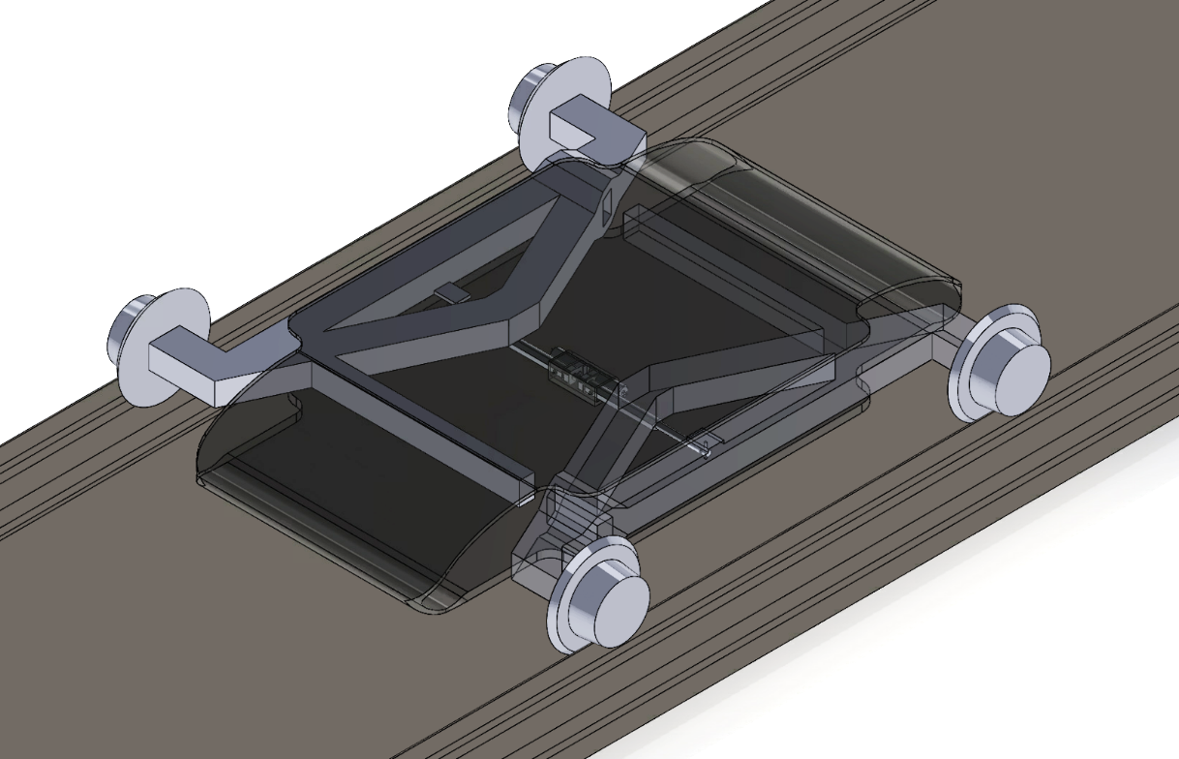
Background
Project Statement
Autonomous, independent vehicle to collect key track data
Detect defects more frequently
Reduce costs & delays
Minimize impact on service
Increase subway growth & efficiency
Autonomous Subway Inspection Vehicle Concept
Notes:
Marcin

Slide 6
Background
Feedback
“Projections for device and sensors?” “Harsh environment.”
Micro-Epsilon Sensor IP 67 (dust tight, submerged 30 min 1 meter of water)
“Locomotion discussion not present”
Battery powered for flexible use
Electric motors
Notes:
Marcin

Slide 7
Background
Feedback
“Too many parameters, will be overwhelmed”
Focus on track gauge
Velocity closed loop control and measurement sync.
Notes:
Marcin

Slide 8
Background
Feedback
“Too many actuators,” “Wheel retraction mechanism confusing/appears too complex”
Simplest design will need more actuators for stability
4 independently actuated (linear) legs most stable for uneven ground
2 linear actuators for wheel retraction to be able to attach directly without more complex mechanisms (linkages)
Also increases retraction range
Notes:
Brandon

Slide 9
Background
Feedback
“Too many actuators,” “Wheel retraction mechanism confusing/appears too complex”
2 horizontal linear actuators will allow system to adapt to different track gauges and systems, increasing market value
Retraction mechanism not possible with a fixed axle
1 motor per wheel is needed to avoid using more complex transmission mechanisms to transmit power to multiple wheels from fewer motors
Notes:
Brandon

Slide 10
Background
Feedback
“Recommended two axle vehicle, third axle with passive measurement systems. Should not be allowed on active tracks, should attach to trains”
Project is to create an autonomous vehicle, not a sensor box
The vehicle is a mechanical engineering project, an attached box is not
Sensor boxes that attach to trains exist, but are expensive due to distance from track and must be retrofitted
Notes:
Brandon

Slide 11
Background
Feedback
“For safety reasons, inspection vehicle should not be allowed to move alone on active tracks”
Team understands the safety issues, effort is being put in the evasion mechanism to ensure max reliability
Positive Train Control System and Communications Based Train Control are new systems in place today that let operators know exactly where trains are
Notes:
Brandon

Slide 12
Background
Feedback
“For safety reasons, inspection vehicle should not be allowed to move alone on active tracks”
Vehicle can be connected to the communications network for trains so that it’s location can be known
Train locations can be relayed to the vehicle so it can get off the tracks while the train passes
Vehicle will be designed to function separately and detect trains regardless of the communication system
Notes:
Brandon

Slide 13
Background
Feedback
“Technical analysis too simple, need statistical analysis of sensors”
More understanding of sensors and vehicle design was needed before going in depth with analysis
Micro-Epsilon sensors are high precision
Low repeatability error
Micrometer resolution
Error margin doubles with two sensors, but still extremely small
Notes:
Brandon

Slide 14
System Design
Notes:
Sean

Slide 15
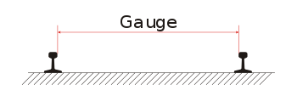
System Design
Sensors and Control
Focus on measuring track gauge
MTA regards as most important
FRA: 15-20% of track issues from wide gauge
Use distance sensors to measure
Inertial data may also need to be collected
Accelerometer and gyroscope
Measurement Control System & Velocity Control System (Closed Loop)
Notes:
Sean

Slide 16
System Design
Sensors and Control
Compared distance sensor types during Phase 1
Inductive
Capacitive
Ultrasonic
Laser
Notes:
Sean

Slide 17
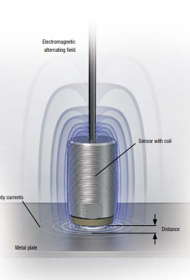
System Design
Sensors and Control
Inductive Distance Sensor
Hard to measure thick metal
High temperature sensitivity
Not reliable above 3 deg. Tilt
Requires large targets relative to sensor, especially over longer range
Not viable
Notes:
Sean

Slide 18
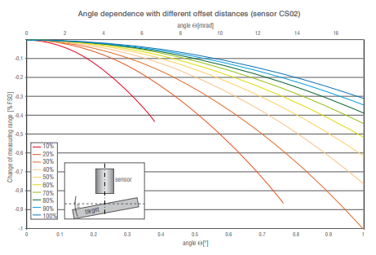
System Design
Sensors and Control
Capacitive Distance Sensor
Also affected by tilt
0.5-0.8% of full scale output (FSO) at 1 deg. tilt
Requires large targets relative to sensor
Not viable
Notes:
Sean

Slide 19
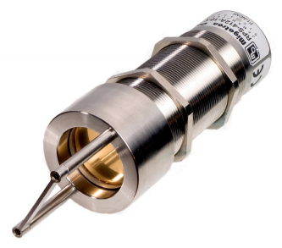
System Design
Sensors and Control
Ultrasonic Distance Sensor
Up to 45 deg. tilt
Requires wide targets
Accuracy dependent on constant air temperature
Not viable
Notes:
Sean

Slide 20
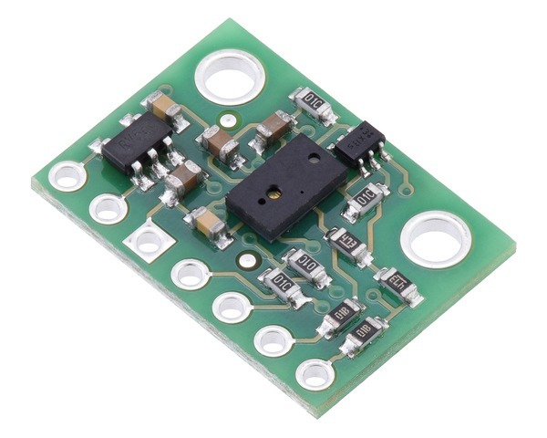
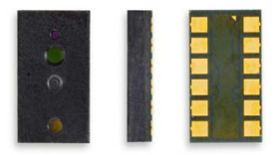
System Design
Sensors and Control
IR Time-of-Flight (TOF) Distance Sensor
Inexpensive
Sensitive to ambient light
IR beam widens over longer ranges
Most have poor resolution (~1cm)
Viable for Alpha Prototype
Notes:
Sean

Slide 21
System Design
Sensors and Control
IR Time-of-Flight (TOF) Distance Sensor
Purchased VL6180X for Alpha Prototype
$8.50
Made for lower ranges
Accuracy up to 1mm at 10cm range
Up to 400kHz communication
Easy to interface with microcontrollers, I²C
Cheap, accurate alternative to lasers
Notes:
Sean

Slide 22
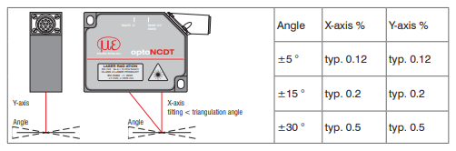
System Design
Sensors and Control
Laser Distance Sensors
Single point, very accurate
Micro-Epsilon sensors
Up to 30 deg. tilt with <1% error
IP67 Rating
Notes:
Sean

Slide 23
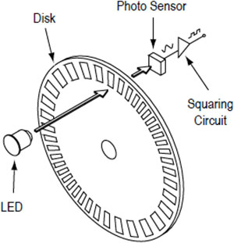
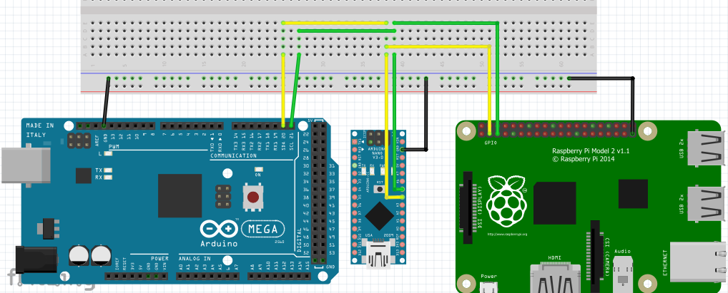
System Design
Sensors and Control
Control
Velocity (closed loop)
Incremental motor encoders
Measurement control systems
Arduino and I²C for high frequency data collection
Master and slave setup for subsystem control
Raspberry Pi as master for computation tasks
Arduino as slaves for control of a specific subsystem
Notes:
Sean

Slide 24
System Design
Sensors and Control
Data Collection
Assuming 25 mph and 1.5kHz max freq. (laser)
Measurement every ~8 mm
1 byte per data point : 5000+ miles per GB
Notes:
Sean

Slide 25
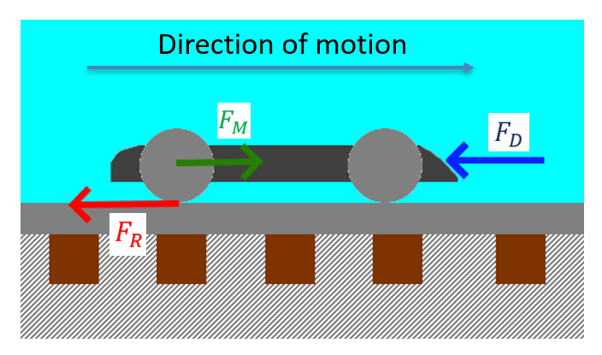
System Design
Technical Analysis
Forces
F_{R} → Rolling Resistance
F_{D} → Air Drag
F_{M} → Motors
Notes:
Noah

Slide 26
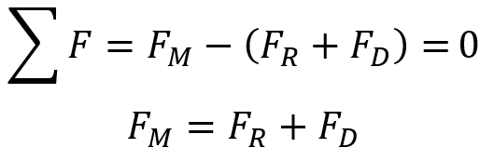
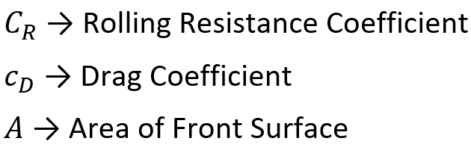
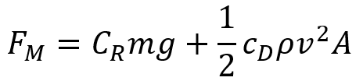
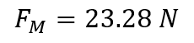
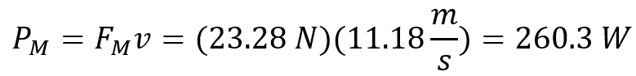
System Design
Technical Analysis – Motor Power
Velocity: 25mph
Notes:
Noah

Slide 27
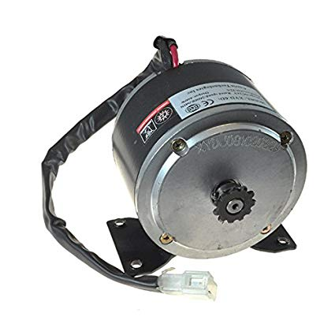
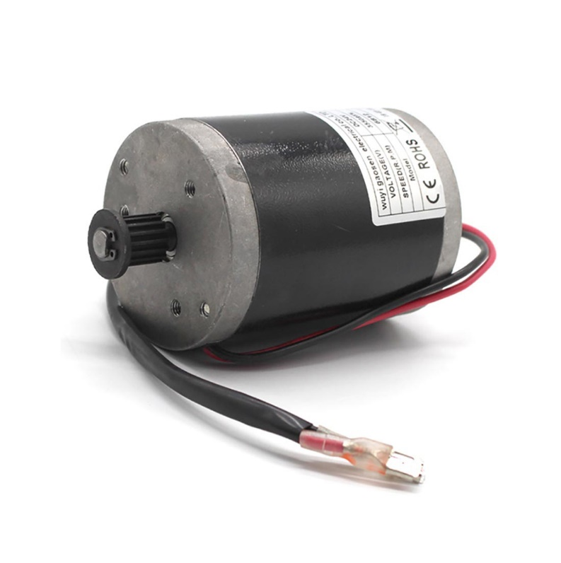
System Design
Technical Analysis – Motor Selection
Single motor (Alpha)
400W DC brushed motor
Rated 22 Amp
2 axle, front powered through chain/sprocket
Four motors (Beta)
4x 100W DC brushed motor
Wheel retraction mechanism does not allow for axles
Better traction, dynamic/independent control for stability
400W Scooter Motor
100W Scooter Motor
Notes:
Noah

Slide 28
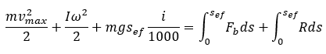
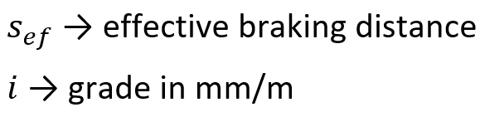
System Design
Technical Analysis – Braking Force
Work-Energy Equation:
Linear Kinetic Energy
Rotational Kinetic Energy
Potential Energy
Braking Work
Resistance Work
Notes:
Noah

Slide 29
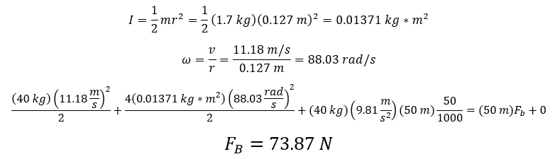
System Design
Technical Analysis – Braking Force
Stop within 50 meters from 25mph at 50mm/m downhill grade, no resistance (Worst-case scenario)
Total Braking Force
Notes:
Noah

Slide 30
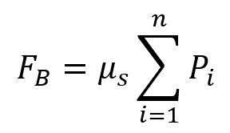
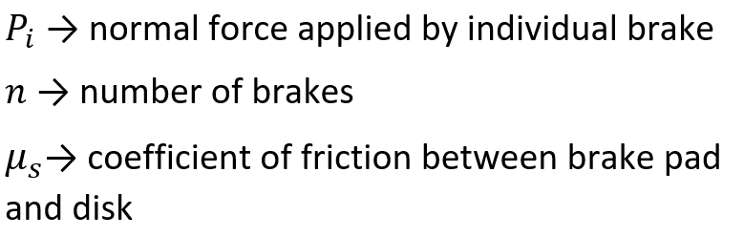
System Design
Technical Analysis – Braking Force
Assuming 4 brakes (1 per wheel) for the beta prototype
Braking Force per Wheel
1 brake for the alpha prototype
184.7 N braking force
Notes:
Noah

Slide 31
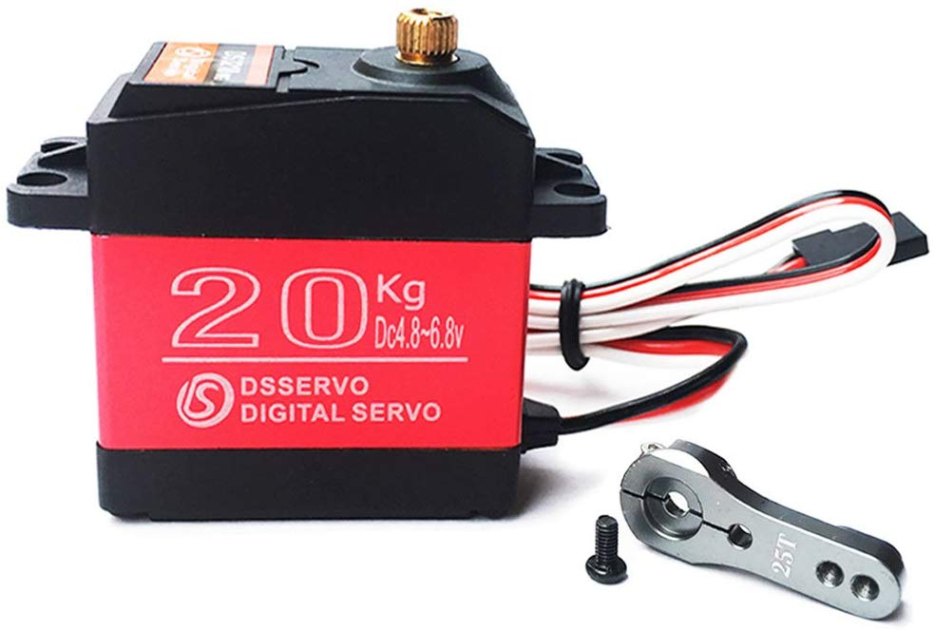
System Design
Technical Analysis – Braking Force
Servo motor (high torque) to pull on brake cable
20kg-cm
Arm length of 25mm
Output force of 78N
For beta prototype
78N per wheel >> 46.2N required
For alpha prototype
78N < 184.7N required
Reduce through use of pulleys or use higher torque servo
Notes:
Noah

Slide 32
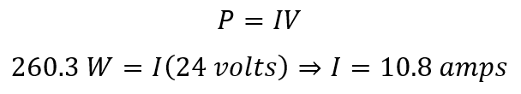
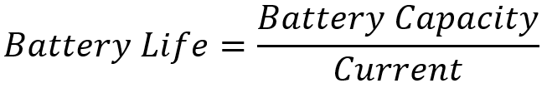
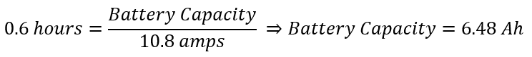
System Design
Technical Analysis – Battery Selection
Assuming 15-mile inspection at 25 mph
36-minute run time
Motors are most power consuming (by large margin)
Notes:
Noah

Slide 33
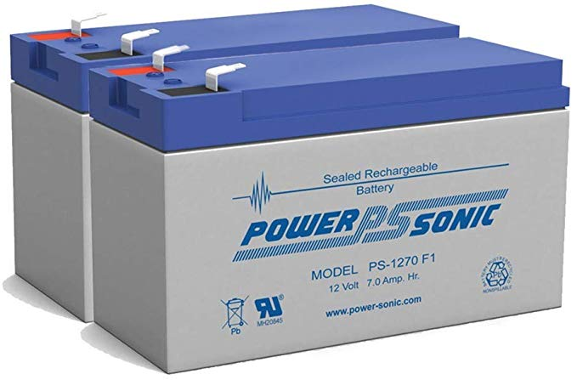
System Design
Technical Analysis – Battery Selection
6.48Ah → 7Ah
Sealed Lead Acid
Safer than Lithium-ion, no fires
2x 12V 7Ah batteries in series
24V 7Ah
24V needed for motors
Notes:
Noah

Slide 34
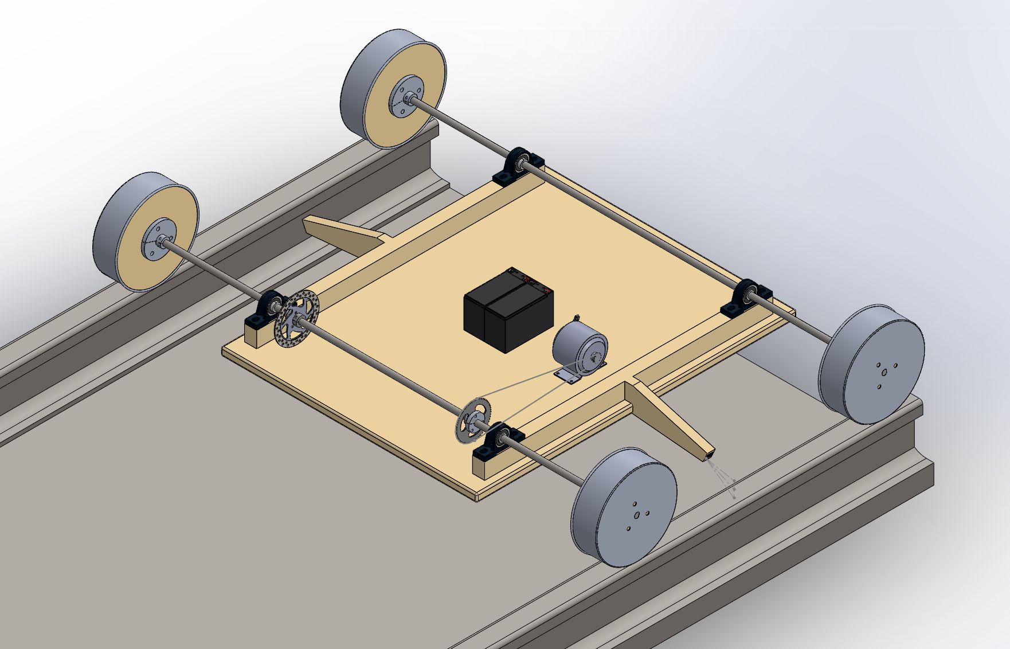
System Design
Alpha Prototype – Isometric View
Notes:
Omar

Slide 35
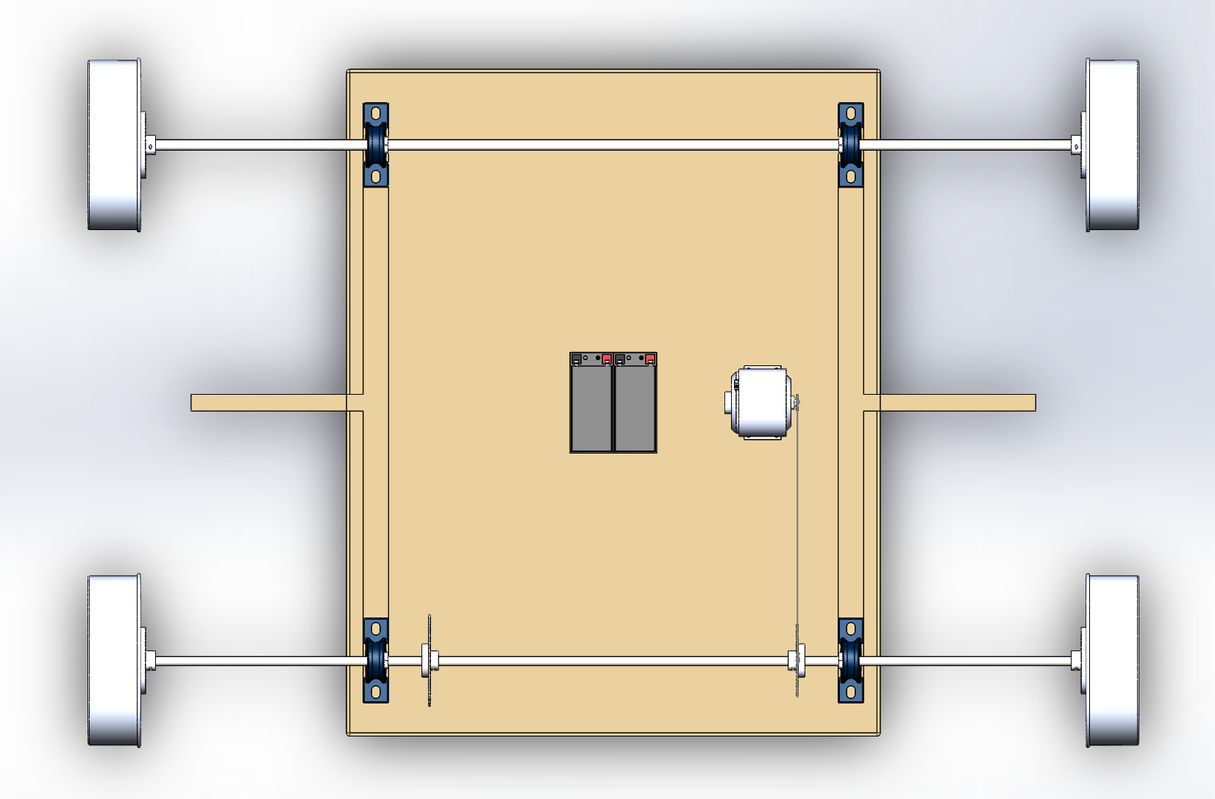
System Design
Alpha Prototype – Top View
Axle
Bearing
Wheel
Batteries
Motor
Sensor Mount
Chain
Disk Brake
Sprocket
Notes:
Omar

Slide 36
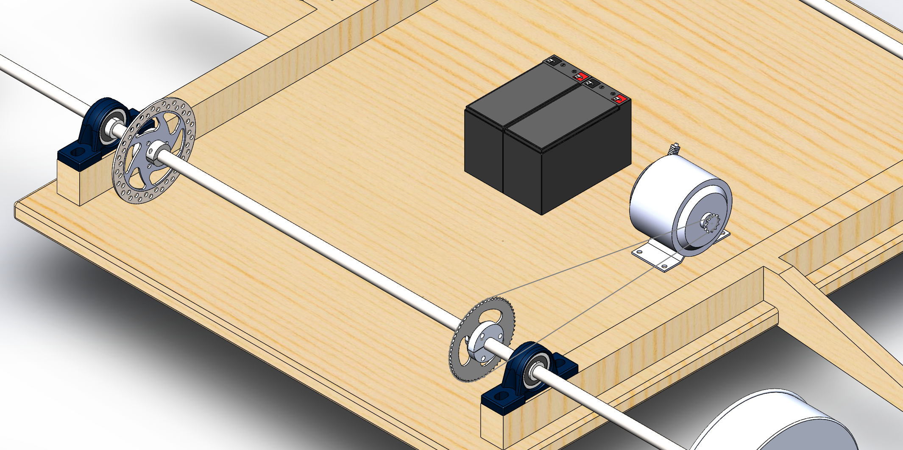
System Design
Alpha Prototype – Close Up
Bearing
Motor
Batteries
Disk Brake
Axle
Chain
Sprocket
Sensor Mount
Wheel
Notes:
Omar

Slide 37
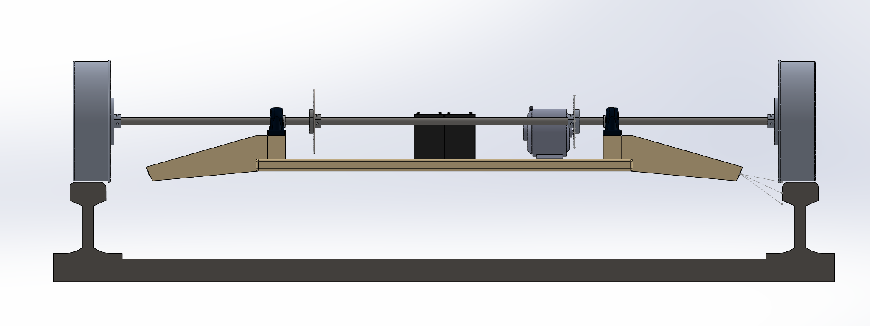
System Design
Alpha Prototype – Front View
Notes:
Omar

Slide 38
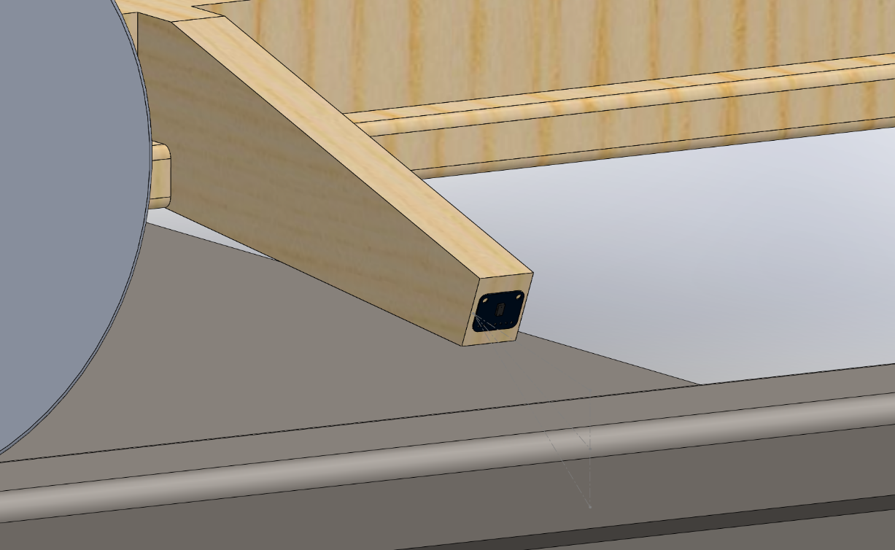
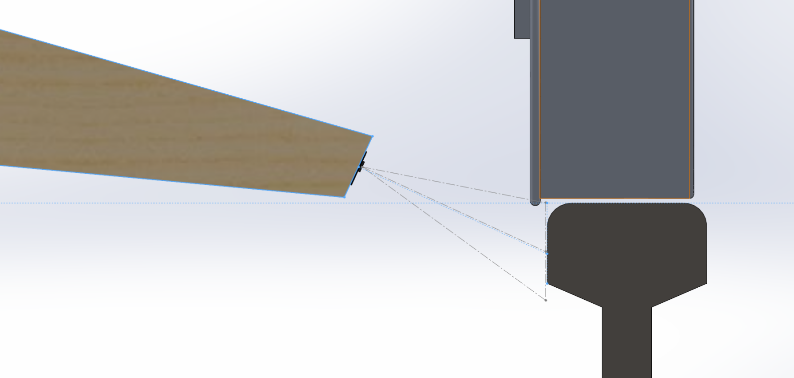
System Design
Alpha Prototype – Sensor Mount
Notes:
Omar

Slide 39
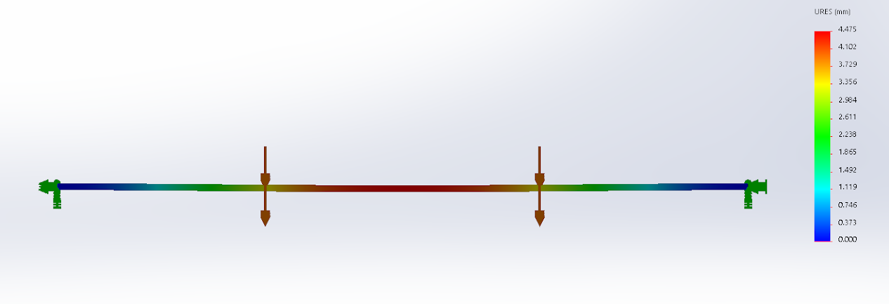
System Design
Alpha Prototype – Axle Analysis
Axle : Stainless Steel 304 5/8” Rod
Deformation analysis assuming 40kg vehicle (100N per bearing)
Max Deformation: ~5mm at center (Acceptable)
100N (Bearing)
100N (Bearing)
Wheel (fixed)
Wheel (fixed)
Notes:
Omar

Slide 40
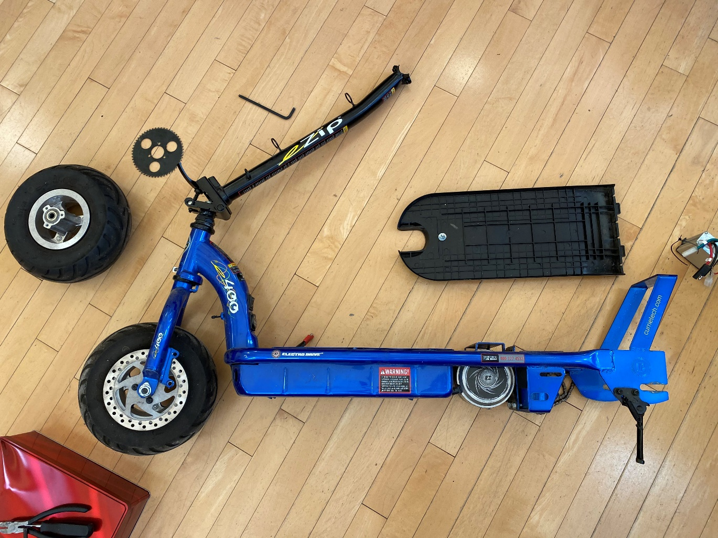
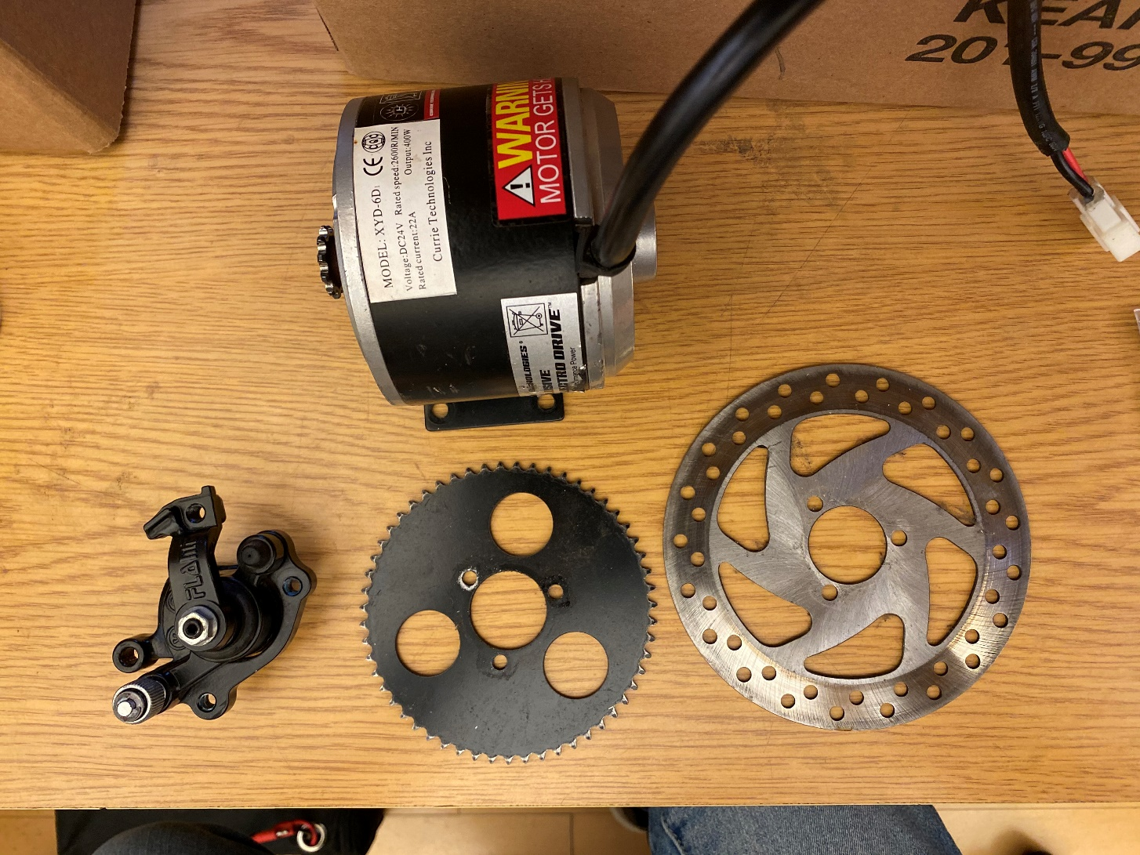
System Design
Alpha Prototype – Progress
Notes:
Omar

Slide 41
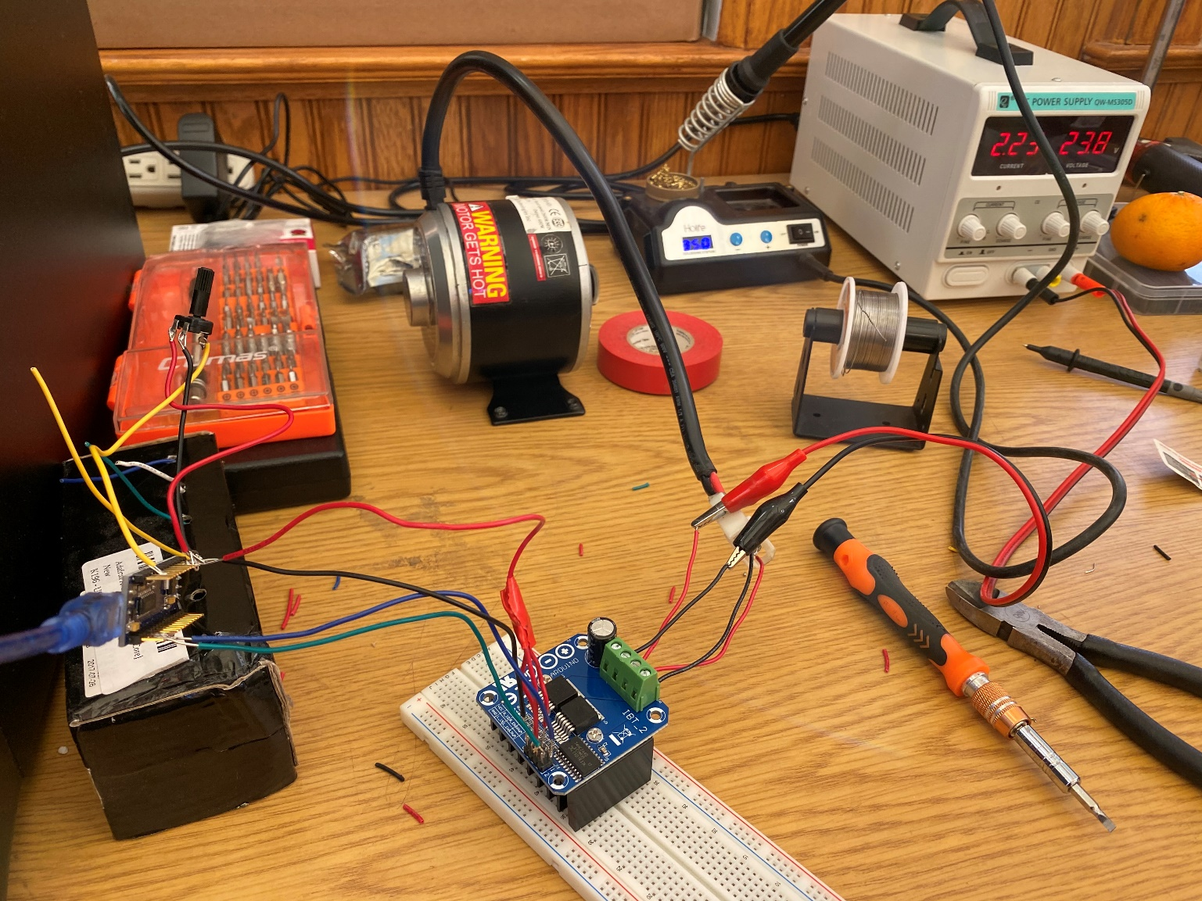
System Design
Alpha Prototype – Progress
Potentiometer
Power Supply
Motor
Arduino Nano
Motor Driver
Notes:
Omar

Slide 42
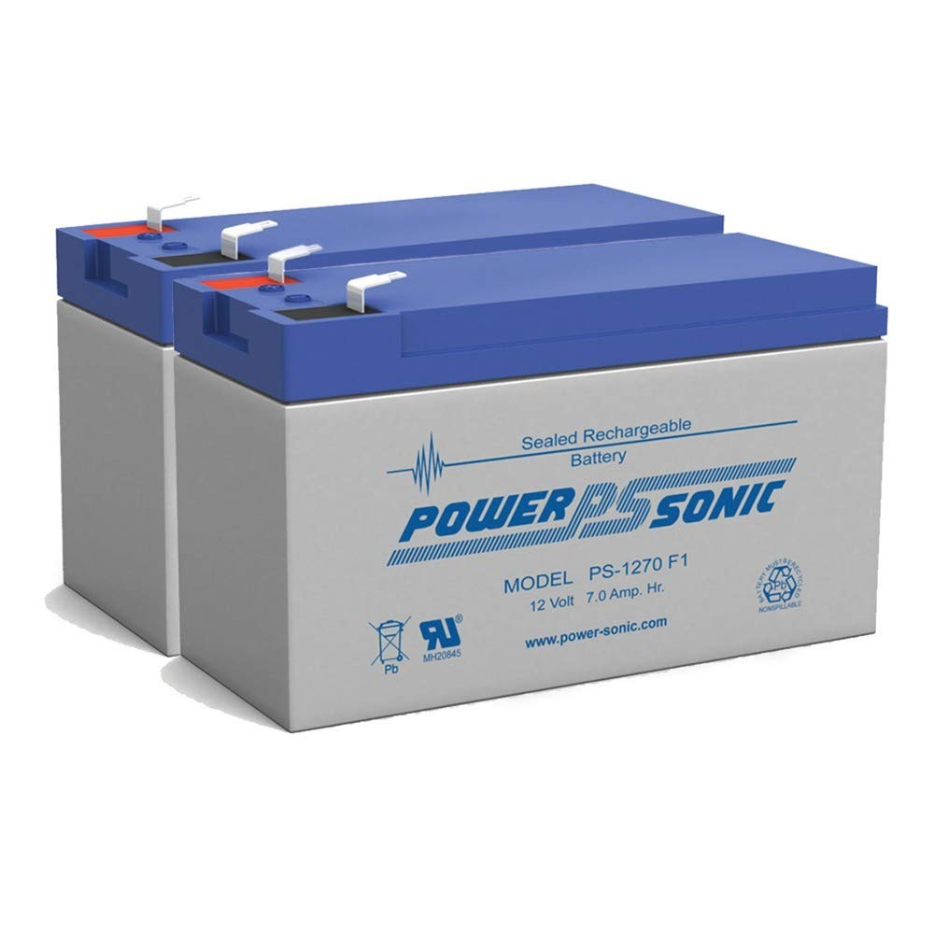
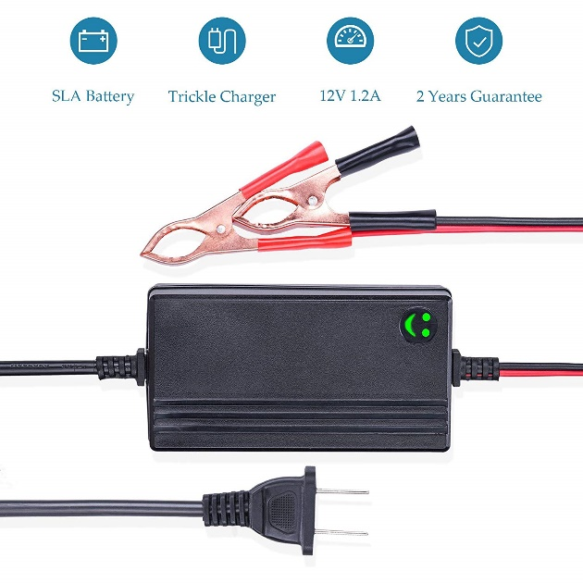
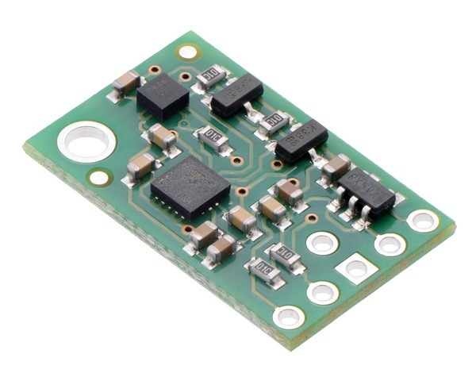
System Design
Alpha Prototype – Progress
Potentiometer
Power Supply
Motor
Arduino Nano
12V 7Ah SLA Batteries
12V 1.2A Phased Charger
Motor Driver
Gyro + Accel + Compass IMU
Notes:
Omar

Slide 43
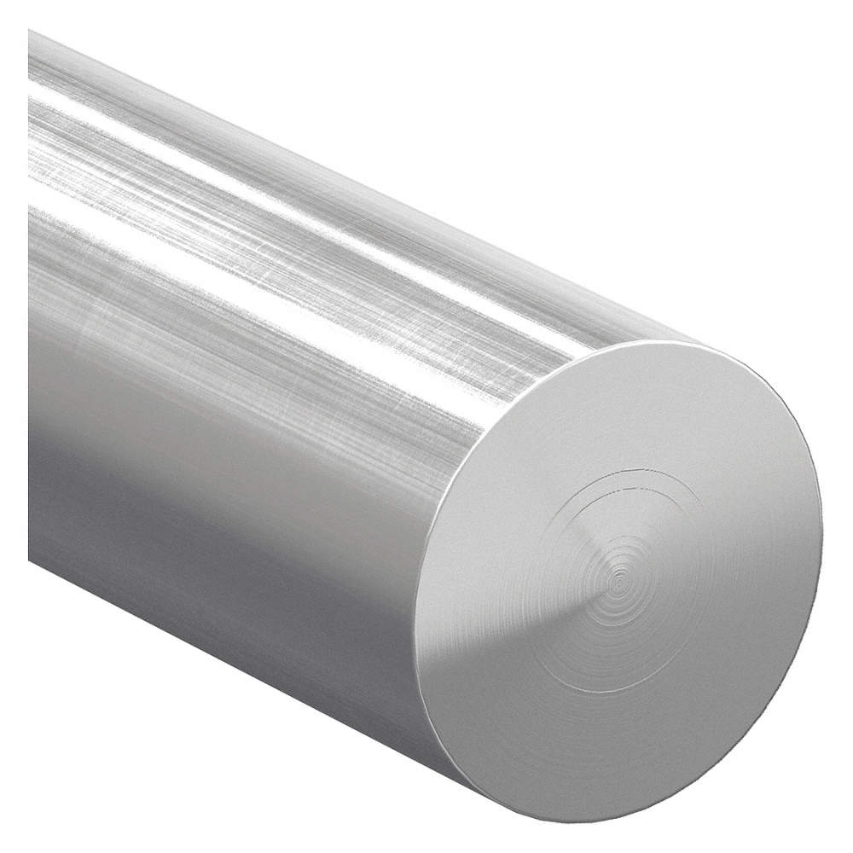
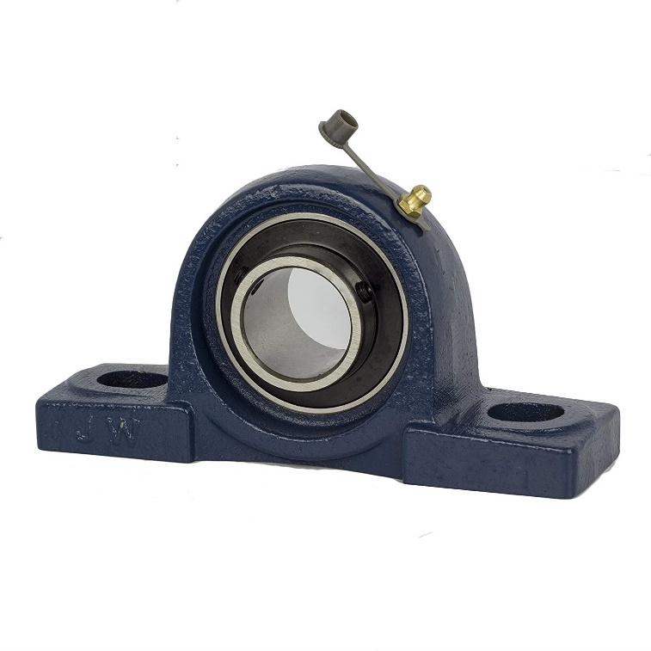
System Design
Alpha Prototype – Progress
Potentiometer
Power Supply
Motor
Arduino Nano
SS 304 5/8” Rod
VL6180X ToF Distance Sensor
Motor Driver
5/8” Pillow Block Bearings
Notes:
Omar

Slide 44
Moving Forward
Notes:
Anthony

Slide 45
Moving Forward
Deliverables
Alpha prototype parts
Track gauge analysis code
Alpha prototype
Testing location
Testing and analysis
Forward recommendation
Notes:
Anthony

Slide 46
Moving Forward
Project Plan - Budget
Purchased Sensors
Item: | Price:
Laser Sensors | Donation from Micro-Epsilon
Gyro + Accelerometer Unit | $15.95
IR Time-of-Flight Sensor (x3) | $25.47
Total: | $41.42
Notes:
Anthony

Slide 47
Moving Forward
Project Plan - Budget
Purchased Parts
Item: | Price:
SS 304 5/8” Rod (x2) | $26.50
Pillow Block Bearings (x4) | $22.58
12V 7AH SLA Battery (x2) | $34.40
12V Battery Charger | $9.99
Total: | $93.47
Remaining Budget: $565
Notes:
Anthony

Slide 48
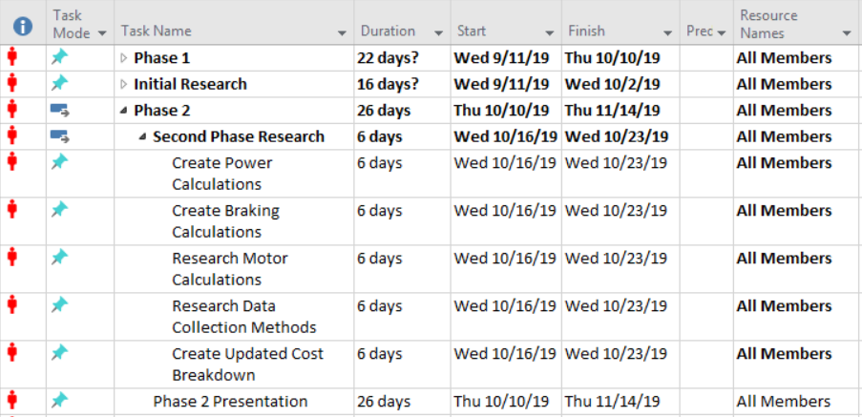
Moving Forward
Project Plan - Timeline
Notes:
Anthony

Slide 49
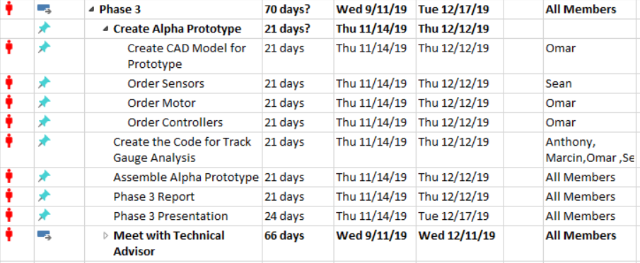
Moving Forward
Project Plan - Timeline
Notes:
Anthony

Slide 50
Moving Forward
Project Plan - Timeline
Phase 4
Test Alpha Prototype
Date: 1/21/2020
Phase 5
Assemble Beta Prototype
Date: TBD March/April
Test Beta Prototype
Date: TBD March/April
Notes:
Anthony

Slide 51
Appendix
Notes:
Anthony

Slide 52
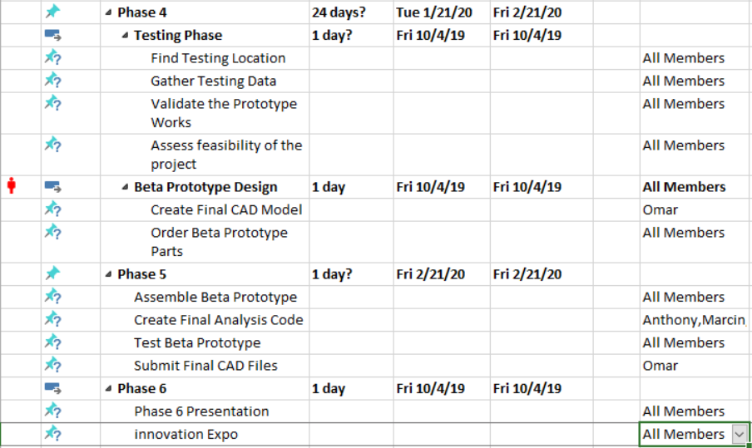
Appendix
Full Gantt Chart
Notes:
Anthony

Slide 53
Appendix
References
TGC - https://www.youtube.com/watch?v=gE0F4aDhwU8
Opto sensor - catalog
AlveyTech 24 Volt 100 Watt Electric Motor for Razor E100, E124, E150, and E175 - https://www.amazon.com/AlveyTech-Volt-Electric-Motor-Razor/dp/B01MTDKNF8
ANNIMOS 20KG Digital Servo High Torque Full Metal Gear Waterproof for RC Model DIY, DS3218MG,Control Angle 270° - https://www.amazon.com/ANNIMOS-Digital-Waterproof-DS3218MG-Control/dp/B076CNKQX4
Powersonic PS1270F1 Replacement Rhino Battery - 2 Pack - https://www.amazon.com/Powersonic-PS1270F1-Replacement-Rhino-Battery/dp/B008AYQ624
Notes:
Anthony

